Slide 1
Keep Calm
& Carry On A Plan for Managing Stress
September 2022

Slide 2
State Employee Assistance Program
This presentation is part of the services provided by the State Employee Assistance Program through Behavioral Health Systems, Inc. The State EAP is administered and managed by the State Department of Finance’s Division of Risk Management (DORM). If you have questions regarding the policy, procedures or services provided by this program, please contact the Program Coordinator, Kwatasian Hunt, at eap.information@finance.alabama.gov. You can also find more information about the State Employee Assistance Program on the Division of Risk Management’s website at www.riskmgt.alabama.gov.
Notes:
IMPORTANT PLEASE READ

Slide 3
Objectives
Discuss why it is important to manage stress and the healthy benefits of coping with stress
Identify the sources of stress in your life both at work and at home
Develop a plan to address the stressors by using the four A’s
Discuss the importance of developing a personal strategy of motivation
Review State of Alabama’s EAP benefits

Slide 4
De-Stressor to Remember
“If you don’t like something, change it; if you can’t change it, change the way you are thinking about it.”
- Mary Engelbreit

Slide 5
What is Stress?
Stress is your body's way of responding to any kind of demand. It can be caused by both good and bad experiences whether at home or at work
When people feel stressed by something going on around them, their bodies react by releasing chemicals into the blood. That is the feeling of your stress level rising

Slide 6
What are Stressors?
Stressors are the causes of stress – any environmental condition that places a physical or emotional demand on the person
Stressors can occur in all facets of our life – at home, at work, even on vacation
Identifying stressors in our lives will help us learn to cope with stress as it increases

Slide 7
Basic Causes of Stress At Home
Injury or illness to any family member or pet
Separation or divorce from partner
Pregnancy or birth of new baby
Children’s behavior
Financial issues
Disagreements with family or friends
Time management of household duties
Finding balance between work and personal life

Slide 8
Basic Causes of Stress At Work
To meet the demands of your job
Relationship with your superiors, colleagues or staff
Staff training and delegation
Ability to meet deadlines
Produce meaningful work
Working overtime or on holidays
Finding balance between work and personal life
Notes:
Work Overload
Working more hours, more intensively than one can cope
Affected by consumerism & technology advancements (cell phone, email, text messages)
Task Control
Lack of control over how and when tasks are performed
Stress increases with responsibility
Time Management Difficulties
Prioritizing tasks and activities
Managing commitments

Slide 9
Basic Causes of Stress Other Factors
Fear of the future
Threats: physical, social, financial or bullying
Uncertainty
Lack of sleep
Being misunderstood
Setback to your position in society
Unhealthy behaviors
Connections with others

Slide 10
Common Facts About Stress
You are not alone in feeling stressed out about home life, work life or just life in general
3 out of 4 people say they experience stress at least twice a month
Over half of those people say they suffer from 'high' levels of stress at least twice a month
In the last 20 years, the number of people reporting that stress affects their work has gone up more than four times
1 in 4 drugs prescribed, of all the drugs prescribed in the United States, go to the treatment of stress

Slide 11
Common Facts About Stress
And at work:
The average business professional has 30 to 100 projects that they are assigned
Today’s workers are interrupted 7 times an hour and distracted up to 2.1 hours a day
40% of adults say they lie awake at night plagued by the stressful events of the day
Four out of 10 people working at large companies are experiencing a major corporate restructuring, and therefore facing uncertainty about their futures
Notes:
Eustress – good stress

Slide 12
The Impact of Stress on Health
Physical Response
Headaches, sickness, feelings of unhealthiness
Behavioral
Absenteeism, aggression, poor decisions, accidents
Psychological
Dissatisfaction or unhappiness, moodiness, depression, fatigue
Notes:
MENTAL
Decreased concentration
Decreased memory
Indecisiveness
Mind racing or going blank
Confusion
PHYSICAL
Fatigue
Disturbed sleep
Headaches
Muscle aches/stiffness
Heart palpitations or chest pain
Frequent colds
Cold extremities or flushing
EMOTIONAL
Anxiety/nervousness
Depression
Anger or frustration
Worry or fear
Irritability or impatience
Short-temperedness
Loss of joy or humor
BEHAVIORAL
Fidgeting or pacing
Nervous habits (biting nails…..)
Increased eating, drinking or smoking
Crying, yelling, swearing or blaming
Hitting or throwing things

Slide 13
Why Manage Stress?
There are times that it may seem like there is nothing you can do about the stress you feel
Bills wont stop coming; there are never enough hours in the day; work is never-ending
The simple realization that you are in control of your LIFE is the foundation of managing stress
Stress management is defined by taking charge: of your lifestyle, thoughts, emotions and the way you respond to challenges

Slide 14
Why Manage Stress?
Most of us today feel like we are living with high levels of stress
This destroys your emotional equilibrium and your physical health
It narrows your ability to think clearly, function effectively and enjoy LIFE
Utilizing the information that you are learning about today and applying it to your life will allow you to live happier, healthier and be more productive

Slide 15
Identify the Sources of Stress in Your Life

Slide 16
What are Stressors that You May be Facing?
State of Alabama’s members:
Demanding work schedules
Family and work/life balance
Health and wellness concerns

Slide 17
How do You Manage Your Stressors?
Questions to ask yourself (or write down):
Do you explain away stress as temporary (“I just have a million things going on right now”) even though you can’t remember the last time you took a breather?
Do you define stress as an integral part of your work or home life (“things are always crazy around here”) or as a part of your personality (“I have a lot of nervous energy, that’s all”)?
Do you blame your stress on other people or outside events, or view it as entirely normal and unexceptional (“If Mark wouldn’t set so many deadlines, I’d be able to get more done”)?

Slide 18
Coping with Stress: Tip #1
Start a Stress Journal
This doesn’t need to be a fancy journal or notebook, any piece(s) of paper can be construed to create a “stress journal.” You can even use the “Notes” function on your phone or iPad
A stress journal will help you identify the regular stressors in your life and how you deal with them
Each time you feel stressed, write it down (or keep a set of post it notes and enter them in at the end of the day)
As you keep the daily log, you will begin to see patterns and common themes

Slide 19
Coping with Stress: Tip #1
Start a Stress Journal (cont.)
Write down:
What caused your stress. Is it a person, project, certain day of the week? If you aren't sure, make a guess
How you felt physically and emotionally
How did you act in response?
What did you do to rise above the stress situation?

Slide 20
Coping with Stress: Tip #1
Start a Stress Journal (cont.)
Example:
What caused your stress? Is it a person, project, certain day of the week? If you aren't sure, make a guess
“Mark set another deadline”
How you felt physically and emotionally
“It caused me to feel flushed and exhausted”

Slide 21
Coping with Stress: Tip #1
Start a Stress Journal (cont.)
Example:
How did you act in response?
“I decided to take a walk around the building and walk the stairs between floors”
What did you do to rise above the stress situation?
“After my five minute break, I looked at my calendar and juggled a few priorities. I let Mark know that one would need to be put off two weeks if I was to make this new deadline”

Slide 22
Identifying What Worked
From the previous example, what were a few coping techniques that the employee used to deal with the stressful situation?
Notes:
Communication – the bottom line was that the employee communicated with the supervisor that he could make the deadline, but that a few other projects would need to be moved around. The key is communication and that was successfully completed AFTER the employee de-stressed.

Slide 23
De-Stressor to Remember
“If I continue to think as I have always thought, I will continue to act as I have always acted.
If I continue to act as I have always acted, I will continue to get what I have always gotten.”
- Achieving Balance

Slide 24
Coping with Stress: Tip #2
Replace Unhealthy Coping Strategies with Healthy Ones
Think about the ways you currently manage and cope with stress in your life. What coping strategies are you using?
Are your coping mechanisms healthy or unhealthy, productive or unproductive?
At times, people cope with stress in ways that can compound the problem AND welcome more stress into their lives

Slide 25
Coping with Stress: Tip #2 Healthy & Unhealthy Ways
Healthy Ways to Cope
Be organized. Manage your day instead of it managing you
Drink plenty of water during the day to stay replenished
Focus on the team approach and stay positive
Work with your supervisor if you are having difficulty keeping up with deadlines
Walking and talking with a friend
Unhealthy Ways to Cope
Procrastinate. The stress will pile up along with the work
Keep fueled on sodas and coffee to keep you going
Complain at work or focus on negative outcomes
Be a slave to your email or phone. One needs downtime to refresh mentally each day
Withdraw from family and friends because they “won’t understand”

Slide 26
Coping with Stress: Tip #2 Healthy & Unhealthy Ways
Healthy Ways to Cope
Eat a healthy breakfast to keep your energy up during the day
Keep a detailed “to do” list so that you can manage priorities
Eliminate drugs and alcohol so that you do not rely on substances to “de-stress”
Keep your stress journal updated to evaluate when peak stress times occur
Unhealthy Ways to Cope
Snack on junk food that satisfies your cravings and provides a “sugar high”
Zone out for hours looking at your phone because you just can’t pay attention
Use drugs or alcohol to relax as a quick relief of the issue
Take it out on your loved ones. It may feel good to yell at those you love because it provides a source of relief

Slide 27
Coping with Stress: Tip #2
Replace Unhealthy Coping Strategies with Healthy Ones
If you find yourself relying on at least one or more of the unhealthy ways of coping with stress, it is time that you try a new method
No single tip works for everyone or in every situation, but if you experiment with different healthy coping ways, you can feel calm and in control in almost every situation

Slide 28
AVOID | ALTER | ADAPT | ACCEPT
Practice the Four A’s of Stress Management

Slide 29
The Four A’s of Stress Management
A – Avoid unnecessary stress
A – Alter the situation
A – Adapt to the stressor
A – Accept the things you cannot change

Slide 30
Avoid Unnecessary Stress
It is not healthy to avoid a stressful situation that needs to be addressed, but you may be surprised by the stressors in your life that you can eliminate
Learn how to say no. Know your limits and stick to them. Whether personal or work life, taking on more than you can handle is a surefire recipe for stress
Avoid people who stress you out. If someone consistently causes you stress, limit the amount of time you devote to them. If it is a family relationship, your EAP can provide counseling to address the issues in an appropriate manner

Slide 31
Avoid Unnecessary Stress
Take control. If the news each day makes you anxious, turn off the TV. If social media is your trigger, then log off the internet. Does grocery shopping with your children raise your blood pressure? Perhaps use an online grocery if you can. Do not subject yourself to situations that increase your stress level if you can eliminate the stressor easily
Pare down your to-do list. This should be the first on everyone’s list of ways to de-stress. If you have too much on your plate, drop tasks that aren't truly necessary and move them to the bottom of the list or delete them altogether

Slide 32
Alter the Situation
If you cannot avoid the situation, then try to alter it. Try these tips to alter the situation and manage your stress response:
Express your feelings instead of bottling them up
Be willing to compromise. At home, at work and with your friendships
Create a balanced schedule and strive for an even work/life balance

Slide 33
Adapt to the Stressor
If you cannot change the stressful situation, change your attitude toward it
Reframe problems. Try to view a tough situation with a more positive perspective. Rather than complaining about traffic, use the extra time to catch up on your favorite podcast or just unload from the day
Adjust your standards. Stop setting up yourself for failure by demanding perfection from yourself
Practice gratitude. When life gets you down, reflect on the positive things you appreciate in your life, including your unique qualities and strengths

Slide 34
Accept the Things You Cannot Change
Some sources of stress are unavoidable like the loss of a loved one, unwelcome change in job duties or a national crisis. Accepting reality may be difficult, but using your coping tips and accepting the situation will allow you to see brighter days ahead
Share your feelings. Expressing what you’ve gone through can be very healing. BHS can assist in finding a support group for you or a loved one. Talk to a counselor or even a trusted friend

Slide 35
Accept the Things You Cannot Change
Look for the upside. When facing major challenges, try to look at the opportunities for personal growth. If your choices contributed to the problem, consider how to learn from those mistakes and move past them
Don’t try to control the uncontrollable. Many things in life are beyond our control – especially the behavior of other people. Rather than obsessing every minute of the day and stressing over them, focus on the things you can control such as how you choose to react

Slide 36
What is Motivation?
Motivation: noun mo·ti·va·tion
: the act or process of giving someone a reason for doing something: the act or process of motivating someone
: the condition of being eager to act or work: the condition of being motivated
: a force or influence that causes someone to do something
Synonyms: boost, encouragement, goad, impetus, incentive, incitation, incitement, instigation, momentum, impulse, provocation, spur, stimulant

Slide 37
Finding and Maintaining Your Motivation
Motivation is a mindset, not an emotion
Motivation is not born solely from an emotional response—feelings are fleeting
Motivation is born from a decision to act—choices that are acted upon come from a change of mind

Slide 38
Your Motivation Comes From Within You

Slide 39
Finding and Maintaining Your Motivation
Motivation burns when fueled by:
Your commitment
Your knowledge
Your creativity
Your passion

Slide 40
Finding and Maintaining Your Motivation
Motivation is sustained or lost in the perspective we chose.
E + I + R = B
Whatever we Experience
+ our Interpretation of that experience + our emotional Response = our Behavior

Slide 41
“Life is 10% what happens to you and 90% how you react to it.”
Charles R. Swindoll

Slide 42
Review of Your EAP Benefits
State of Alabama

Slide 43
State of Alabama: EAP Benefits
All employees and dependents may receive up to three (3) visits/consults at no charge each year.
Behavioral
Speak with Counselors
Referrals for mental/ behavioral health & substance abuse issues
Financial
Speak with Advisors
Assistance with budgeting, estate planning, college, debt restructuring, etc.
Eldercare
Speak with Professionals
Help with nursing home & assisted living placement, caregiver issues, etc.
Well-Being
Speak with Work/Life Specialists
Help with stress, emotional health, work/life balance, etc.

Slide 44
Accessing the EAP
Begins with a call to BHS: 800-245-1150
BHS Care Coordinator is available Monday-Friday from 7:30 a.m. – 5:00 p.m. CT
Your BHS Care Coordinator will:
Verify personal information to confirm benefit eligibility
Ask a few questions about needs and preferences
Assist in referring to the appropriate counselor or provider
After hour, weekend and holiday calls answered by licensed mental health professionals – never an automated response system

Slide 45
Accessing the EAP
Dedicated BHS Care Coordinator
When you call BHS, you will speak with the BHS Care Coordinator assigned specifically to the State of Alabama
Marie Wilbanks / Emme Blankenship Care Coordinator
1-800-245-1150
BHS Care Coordinators
Caring, knowledgeable, credentialed counseling professionals who have been selected for their commitment to treat everyone with sensitivity, respect and concern

Slide 46
BHS Website:
www.behavioralhealthsystems.com
Access to:
Enhanced Member Section detailing your unique benefits and services (Member Access)
Member Tips & Resources
Self-Assessment Tools
Appointment Requests
Online Work/Life (password: DORM):
Lifestyle tools to support a healthy work/life balance
Extensive library providing access to relevant articles, seminars, self-help information, news items and more

Slide 47
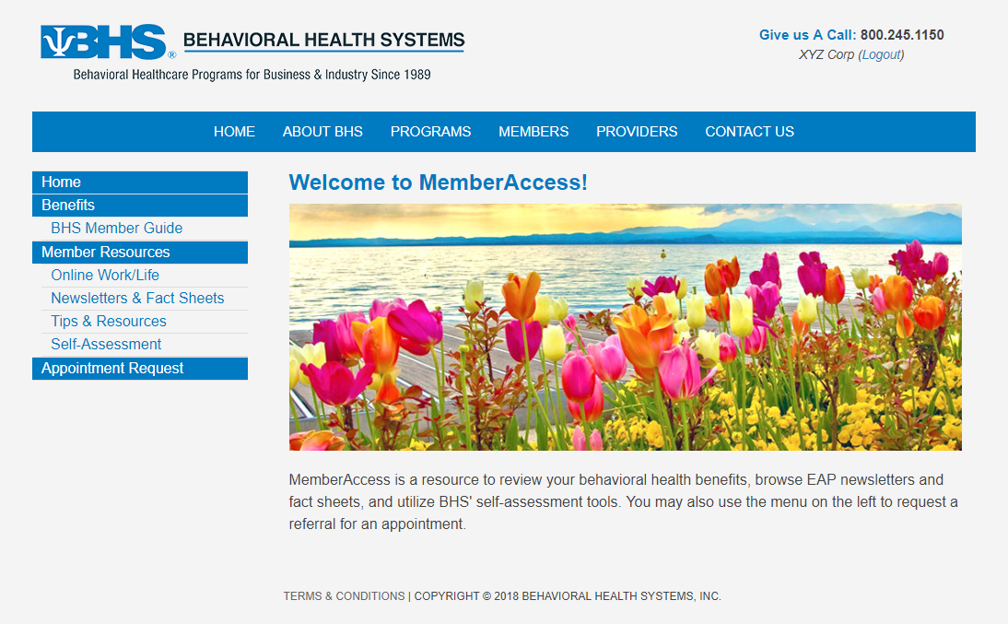
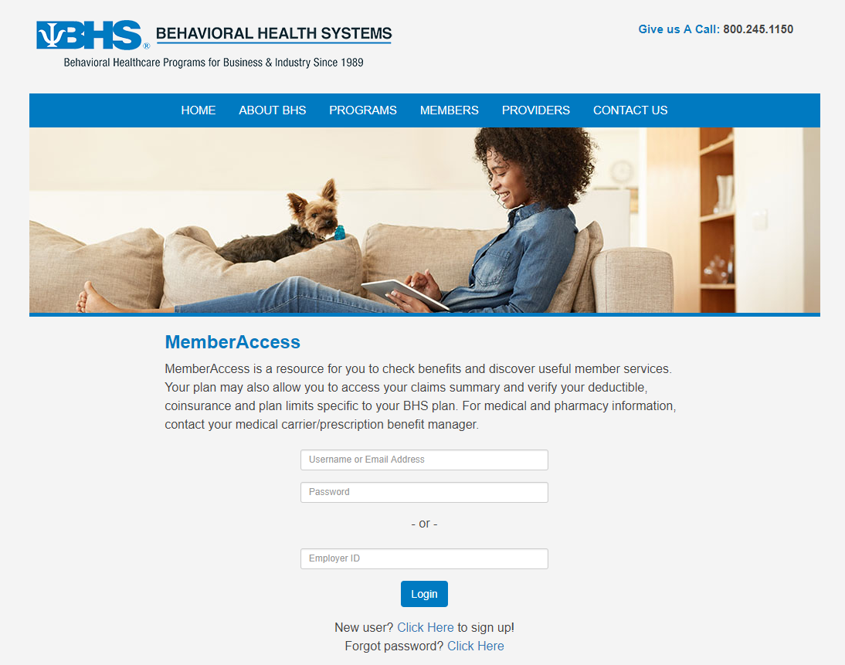
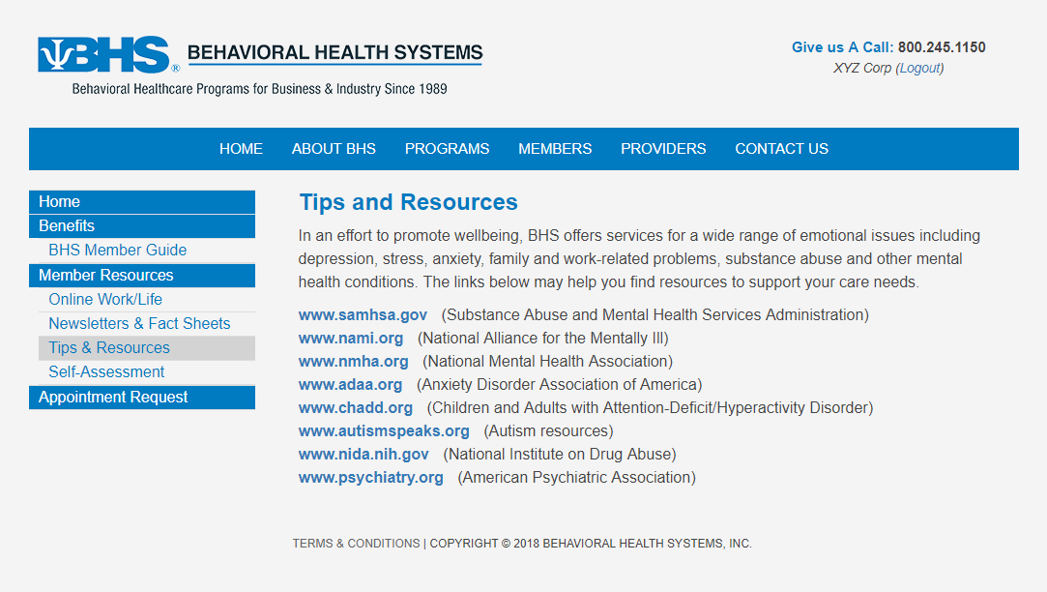
More Information About Your EAP Benefit www.behavioralhealthsystems.com
BHS Website
Resources
Access to:
Benefit Information
Member Tips & Resources
Self-Assessment tools
Newsletters & Fact Sheets
Appointment Requests
Two ways to login to MemberAccess:
Use your Employer ID: DORM
Create a unique user login
Notes:
More information about your EAP benefit is available at our website. Enter the Members section, click on Member Login and enter your password, DORM, to view your member guide and to use self-assessment tools.

Slide 48
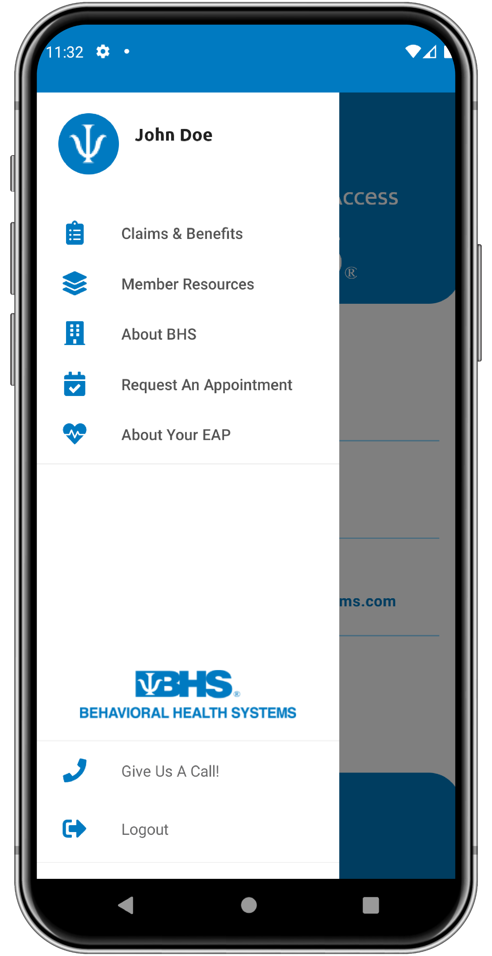
Introducing BHS MemberAccess Mobile App
Now Available!
Now it’s Easier Than Ever to Access…
Benefit Information
Member Tips & Resources
Self-Assessment Tools
Newsletters & Fact Sheets
Appointment Requests
Reimbursement Forms
Online Work/Life
Two ways to login:
Use your Employer ID: DORM
Create a Unique User Login

Slide 49
Keep Calm
& Carry On A Plan for Managing Stress
September 2022

